Slide 1
FE TECH MEETUP India tech hub
Web performance

Slide 2
Web Performance
Web performance is all about making websites fast, including making slow processes seem fast
Web performance refers to how quickly site content loads and renders in a web browser, and how well it responds to user interaction
Part of good user experience is ensuring the content is quick to load and responsive to user interaction. This is known as web performance

Slide 3
Why Web PERFORMANCE
Bad performing sites increase site abandonment
Site speed directly affects bounce rates, conversion, revenue, user satisfaction, and search engine ranking
Performance impacts conversion; improving web performance improves conversion. Site visitors expect a site to load in two seconds or less; sometimes even less on mobile (where it generally takes longer). These same site visitors begin abandoning slow sites at 3 seconds.
Research also concludes that a one-second delay in page load speed can translate into a 7% reduction in conversion rates.

Slide 4
HOW the website loads
Navigation
DNS Lookup
TCP Handshake
Response
Parsing + Render(Critical path rendering)
Interactivity

Slide 5
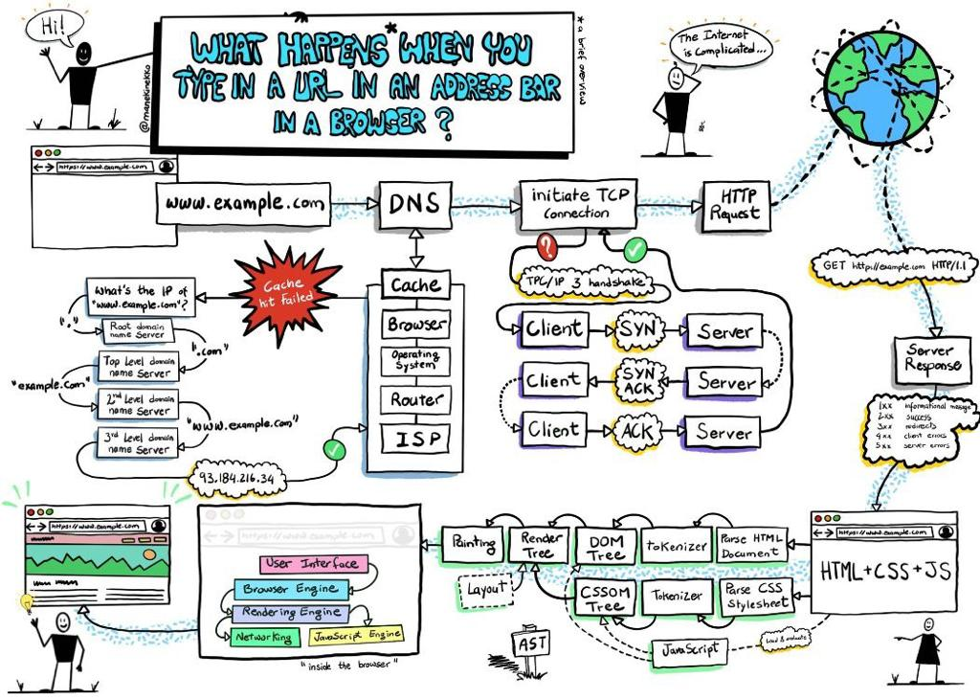

Slide 6
Factors affecting web performance
1. Web hosting
2. Size of files
3. Number of HTTP requests.
4. Absence of CDN
5. Mediocre coding
6. The number of redirections
7. Hotlinking

Slide 7
Tools for Measuring web performance
Lighthouse
https://pagespeed.web.dev/
https://www.webpagetest.org/
https://gtmetrix.com/

Slide 8
METRICS IN web performance
First Contentful Paint (FCP)- is a performance metric that refers to the first pixels that are getting rendered after the users access your website and how long it takes for the user to see them.
Time to Interactive (TTI)- which measures the time until the application is rendered and can respond to user input.
Largest Contentful Paint (LCP)- is a metric that reports the render time of the largest image or text block visible within the viewport, relative to when the page first started loading .To provide a good user experience, sites should strive to have Largest Contentful Paint of 2.5 seconds or less.
Cumulative Layout shift (CLS)- is a measure of the largest burst of layout shift scores for every unexpected layout shift that occurs during the entire lifespan of a page.
Total Blocking time (TBT) - measures the total amount of time between First Contentful Paint and Time To Interactive when the main thread is blocked from responding to user input.

Slide 9
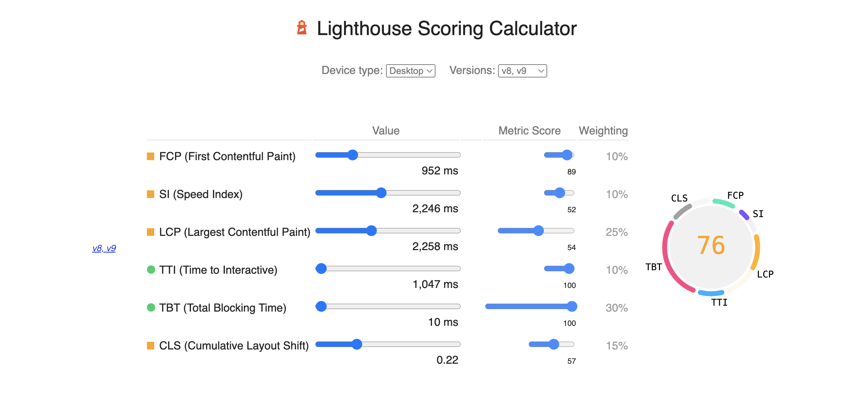

Slide 10
IMPROVE PERFORMANCE IN WEB APPLICATIONS
Page load time
Minify CSS and JS contents
Optimize images + web fonts
Use Cache headers
Encourage Lazy loading on contents wherever possible
Minimizing the number of requests
Avoid iframes and redirects
Use browser cache

Slide 11
REACT PROFILING
React 16.5+ adds support for a new DevTools profiler plugin, You need to install react Dev tool Extension in the browser to be able to record the application performance in the profiler tab
The Profiler tab is very convenient as it provides a visual representation of render times and allows navigation through commits while viewing props and states of components. As a result, it allows for faster analysis and investigation of performance issues`
Recording Performance- Once the you are ready, you can record the application profiler – Click on the Record button in the Profiler tab, Use the application as you would usually and then click on the red record button to stop the recording
Reading Performance -React works in two phases - Render phase and Commit phase, the React profiler collects information in the commit phase and groups the performance info by a commit.

Slide 12
POINTS Performance in react applications
Avoid Reconciliation - Memoizing React components + useCallbacks to prevent unnecessary re-renders
Keeping component state local where possible and closer to the component
Follow react best practices - Avoid overuse of useEffect + useState
Virtualization- react-window and react-virtualized
Immutable data structure

Slide 13
Q & A

Slide 14
REFERENCES
https://developer.mozilla.org/en-US/docs/Learn/Performance
https://www.plerdy.com/blog/website-speed-factors-and-tools/
https://web.dev/lcp/
https://reactjs.org/docs/optimizing-performance.html

Slide 15
Thank YOU

